Slide 1
ARE YOU READY
TO
HAVE YOUR MIND
RENEWED?
“For no one can lay a foundation other than the one already laid, which is Jesus Christ”
(1 Corinthians 3:11)
Notes:
As you work through this document you will find that I have tried to replicate what I said verbally to the Zoom Bible Study group by keyboarding in the message of the slide in the “Notes” box at the bottom of the slide. After studying the main slide image, place your cursor over the top line on the “notes” box below the main slide where my explanation is written. As you move your mouse around slowly two short parallel horizontal lines will appear with two arrows: one pointing up and one pointing down. Left click your mouse on these two lines and now move the mouse up and the notes box will open larger to expose the narrative. The main slide image will reduce in size when you do that. When finished with the text move the notes window down and the full slide image will reappear. The notes box can also be scrolled up or down by use of the up and down arrows and the slider to the right of the notes box.

Slide 2
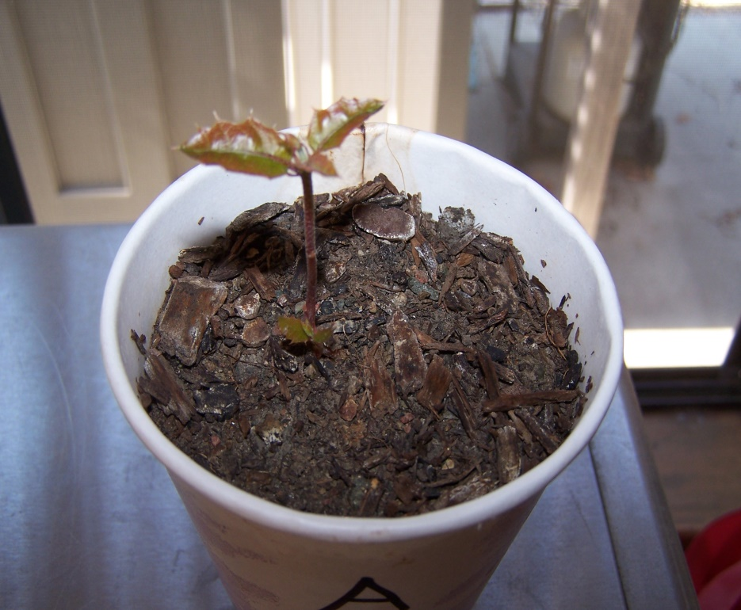
Notes:
The experience you are about to have has an enormous potential of changing how you perceive your Christianity! To give you an analogy of what the magnitude of that potential is I started my discussions by using an oak tree that has grown in my neighbors yard for the past forty years. It is pictured on the right and its branches have extended over into our yard for some time now. One day I picked up one of the acorns that had dropped from the tree and planted it. What appears in the Styrofoam cup to the left in the photo was the result at about three weeks after breaking though the soil after germination. It occurred to me that bible truth is very much like what I had witnessed in this physical example of plant life as it is very much parallel to our spiritual life. It starts from a very small beginning but has the potential of growing in magnitude to the contrast of the two trees shown in the photographs. That is my hope for you and I also in what we will be discussing in the following Christianity topics!
The growth, however, is actually based upon knowledge in our situation. Christians, for the most part, have a knowledge deficit in what they know about this God that we love and the Apostle Paul indicates in the Scriptures that was also the case during his lifetime. I placed on the slide an Old Testament definition of the Hebrew word “yada” and the New Testament word “oida” or “ginosko” which are the Bible language words that describe the knowledge that I am speaking of. Paul makes numerous statements to the people he is speaking and writing to on this topic I have indicated toward the bottom of the slide. The fact that “knowing” is mentioned over 1, 450 times in the bible should be all we require to conclude that we need to pay attention to this subject!

Slide 3
Notes:
The above slide is a bedrock principle of what I have to say to you. Too many Christians are eager to tell you what you must believe about your Christianity and most of them do not support their beliefs by sound Bible exegesis, that is, what the Bible text actually says about their belief. My approach is different. I am going to tell you what I believe and why I believe it using the Scriptures. You, on the other hand, must never be like a sheep an just follow the crowd, but rather should follow the Apostle Paul’s admonition to the Bereans. “Now these Jews were more noble than those in Thessalonica, for they received the word with all eagerness, examining the scriptures daily to see if these things were so” (Acts 17:10, 11). Stop and think about that passage. The Bereans listened to what Paul had to say, but they checked it out in the Scriptures! If they were verifying a man of Paul’s status it seems to me that we Christians today ought to be exercising the same standards for (1) what I will be telling you, and (2) certainly what you might hear coming from behind a pulpit, or from the media, or in your reading of Christian literature! That is your responsibility.

Slide 4
Notes:
You are going to discover from what I write in all of these slide presentations that Christ will be central in everything I write. It must be that way because that is the way God’s plan, that He created before the foundation of the world has been established. To many Christians have had drilled into them that Christianity is all about you! This is not biblical at all. Christianity is ALL ABOUT CHRIST!
Secondly, we humans have a serious problem with attempting to visualize what God is like and we usually end up making Him a lot like ourselves. Bad idea to have. In these presentations you are going to have to totally modify that kind of thinking into someone so large and powerful that He is able to speak into existence out of nothing but His spoken word the entire universe and everything that is in it! That is what the God of Christianity is like!

Slide 5
Notes:
The John 8:36 verse that appears at the top of this slide is, in my opinion (IMO), sorely lacking in Christianity today and has been fro many years because of misinterpreting the thrust of the Bible by many who have become enthroned in Christianity by the sheep that follow them. Jesus clearly states that the content of this verse is one of the reasons He came to earth in a physical body like man to set humanity free and that freedom would be complete in all respects. It would be totally unfettered from the numerous bondages placed upon the sheep by “leaders” who, thinking they are doing God’s will, place unnecessary burdens upon believers resulting in control being exercised over the believer by another mere believer inserting him/herself between the believer and God. Although that was a part of the Old Covenant (to be explained in detail later) where a physical priesthood existed, it has no place whatsoever in the New Covenant in which we Christians live today.
The above common practice found today in Christian fellowships is what I call the difference between “religion” and “Christianity.” Both those words being defined on the slide. This oppressive atmosphere created in these fellowships form what I refer to above as a “glass ceiling” preventing believers from experiencing the full and complete freedom that Christ not only came to earth to provide and which He fully accomplished as part of the monumental event that took place due to His sacrificial death on the Cross!
This religious glass ceiling is made up of man made traditions, misinterpretations of Bible passages and also not rightly dividing them properly as we are told to do in 2 Timothy 2:15 along with unbiblical doctrines, emphasis on the physical realm to the detriment of the spiritual realm, and a “carrot on the stick” mentality to keep the sheep working instead of being what God has already provided for ALL believers – FREEDOM!

Slide 6
Notes:
The slide above reflects IMO a truth we need to adopt insofar as our handling of the word of God. That is, the Bible is a spiritual book which contains a large amount of text describing a large number of physical historical events. But buried in many of these events is a spiritual meaning that is revealed to us when we (1) study and become familiar with the Bible text in its entirety, and (2) listen to the promptings of the Holy Spirit, who along with the entire Godhead, spiritually lives (indwells) the believer from the instant of their first belief in Christ. More on this later.
Another common error Christians make that is pointed out on the slide above is to often Christians read the Scriptures to find out (1) what they have to do to please God, and (2) what they have to do to be considered “good” Christians. Believers have been influenced heavily by other Christians, including those from behind pulpits, that they have to be what I perceive as “doers” rather than “be ers” being what God has already finished for them. There is a simple Bible passage that should settle this for most of you readers. It was the same answer that Jesus gave to His disciples when He was here on earth as Jesus of Nazareth. The disciples asked Jesus, “What must we do , to be doing the works of God? Jesus answered them, This is the work of God, that you believe in him whom he has sent” (John 6:28, 29). That passage, when rightly divided, is a New Covenant passage applicable to us today just as it was when Jesus spoke it to His disciples.

Slide 7
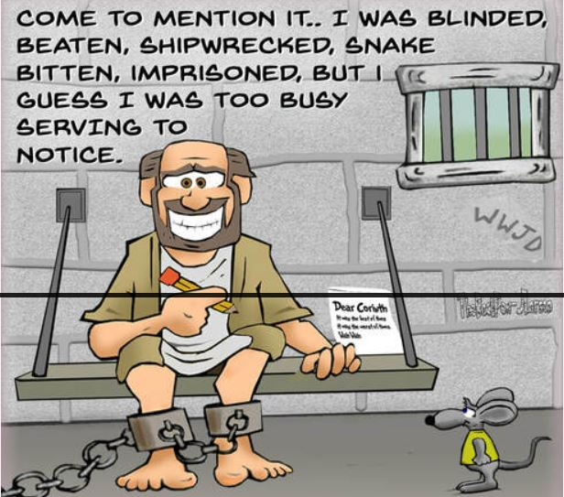
Notes:
As we proceed ahead I would be remiss if I did not share with you that there is a possible condition of “suffering” ahead for you depending upon what Christian friends and acquaintances you now have. First let’s go through the side above. If after studying the topics I will be presenting you are led to accept them as being biblical truth and you share that truth with others, you will no doubt, at some time, become exposed to the same conditions as those mentioned above encountered.
Jesus never told anything that was not truth and look at what His truthfulness resulted in.
The Apostle Paul experienced a similar set of results of his telling the truth. Become familiar with the list above.
Peter was no exception to the same kind of treatment as was the Apostle John.
What the above should point out to you is that although we are not going to be confronted by the exact same Jewish Pharisees that those above had to deal with, that same pharisaic attitude and mind set exists today and unfortunately is focused in the heart of the Christian groups that you may now be a part of. This has the potential of trouble in the physical real in the form of persecution, misunderstandings, exclusion from fellowship, and the list goes on. Fortunately for us it does not go the extremes of physical death as was manifested in the listing on the slide, but it can be very hurtful when your “best friends” turn against you only because you told them the truth. You may get little satisfaction from the Galatians verse above that should attempt to soften this experience, but be prepared for it because very few people who have believed something for an extensive period of time will exhibit the joy you have in your freedom in Christ if and when you share the truths I will be sharing with you in these slide series. Be prepared as Paul was in the cartoon by Jeff Larson of the web site, The Back Pew, depicts above.

Slide 8
Notes:
During our time together the question may arise as to how so many people could have been wrong for so long a period of time? The answer is not unique to spiritual concerns alone and the historical record indicates this weakness in mankind and I have placed a few examples on the above slide to support this weakness. It is easy to see that vast numbers of people can be believing inaccurate information and the fact that they are part of a large number of people believing the same misinformation does not make it any more true. As stated in one of the items above, “a majority opinion may lend credibility to a debate but it does not establish truth! Insofar as the illustration used by professional food experts, in my lifetime the illustration has been radically changed three times! So it goes with spirituality and interpreting the Bible.

Slide 9
Notes:
Some Christians, IMO go overboard when studying where they will not even consider the writings of another Christian or for that matter any person writing from any professional discipline. This to me is foolish because valuable insights can be found in all that is available provided we compare it with the arbitrator of all truth and that is the Bible. We need to treat what are called “extra biblical sources in the same manner that the Bereans did by seeing what it is the Bible has to say about what it is we are studying. In the final evaluation we must always honor and obey what God has said if in fact it is a question that the bible addresses!

Slide 10
Notes:
We will talk about what in the Bible is called the “mind” and how that item fits in with the person as a whole in the next slide, but right now I would like to call your attention to a basic admonition Paul writes about with reference to the mind.
“To set the mind on the flesh is death, but to set the mind on the Spirit is life and peace” (Romans 8:6).
“Do not be conformed to this world but be transformed by the renewal of your mind, that you may prove what is the will of God, what is good and acceptable and perfect” (Romans 12:2).
“and be renewed in the spirit of your minds” (Ephesians 4:23).
When I read those passages it makes an impact on me that whatever I bring in my mind to my new found Christianity is overloaded with worldly values, understandings, and priorities, and God has ready for me to have these replaced with what the Bible has to say about these same items. As my slide indicates above these are my worldly traditions and they are difficult for many Christians to overcome because it means change and change is something that is generally resisted by human beings even to the extent that we oftentimes show our discontent to anyone that may be bringing this truth to us!

Slide 11
The Body is a physical entity
The Soul & Spirit are spiritual entities!
Notes:
The previous slide leads us into the basic topic of: What does man consist of? This question is generally explained either using an illustration of three concentric circles or in my case above, three nested rectangles or two boxes inside of a third box. Those three main figures are used to depict Body, Soul, and Spirit. In order for you and I to communicate with a common language we need to define what these terms mean as we will be using them, as will the Bible, as we move forward in our studies. As the illustration indicates, the body is a physical entity and we humans have no problem in visualizing that item as we deal with it tangibly every day of our lives here on earth.
Inside of the blue body rectangle is the red item labeled soul. The soul, you will discover, consists of three entities: The mind, the will, and the motions. A unique feature of these entities is that if an autopsy were conducted on any human being body, the medical professional performing the autopsy would be able to find and remove many items from the body, but they would NEVER be able to take out an entity called the mind, the will, or the emotions! That is because these entities are NOT physical items at all – they are invisible, spiritual entities! We will speak about these entities of the soul frequently in our discussions ahead of us.
The third rectangle is indicated in yellow and is labeled Spirit. This will also be a critical entity of discussion and it, like the soul, is also a spiritual entity.

Slide 12
Notes:
Starting in the upper left hand corner of the slide we have some introductory information on the body. The Matthew 10 passage gives us a good start on some of the important things that the Bible tells us about this part of man. It informs us that other men can kill the body but we should not fear them because the soul and spirit is much more important than the body, IMO, because they can be the eternal part of us but not the physical body is not eternal. Put another way, if our physical is destroyed in any manner, the spiritual part of us, if we have eternal life, still remains free forever from any demise of our physical body.
In the lower left hand corner we have information about the soul comprised of the mind, will, and emotions. I have called these entities immaterial or non-material because they are spiritual in substance (or perhaps lack of substance) in contrast to the physical body. The two Bible verses appear on the chart to prove the validity of the soul as found in the Scriptures.
In the upper right hand corner I have provided but two of the numerous passages that tell is there is such an entity as the spirit.
In the lower right hand corner I indicate that 1 Thessalonians in a single passage refers to all three entities of body, soul, and spirit. Since 1 Thessalonians is believed to have been written in AD 50, I state that as being the reason why the passage infers that the coming of the Lord is yet future because, as we will later study in this series of document, the return of Christ did not take place until AD 70 which was twenty years later.

Slide 13
Notes:
In the upper left hand corner of the slide I have called your attention to a Bible passage that I would estimate that less than 10% of Christians are even aware of, and sadly so. Paul informs us that Christians are NOT supposed to be evaluating or judging other people from a human point of view! What does that mean? To my understanding a human point of view has to be what we see each person doing in this world and that can only be the actions of the physical body because everything else is spiritual or unseen! Paul even goes on to say we are not even to think of Jesus of Nazareth in that manner which means to me we are to focus on the risen Christ! So how do we regard all humanity? Again, I can only think of two ways: there are only two categories of human beings, those who are currently eternally lost and those who have eternal life!
This brings up the topic of judgment. I can’t tell you how often I have heard other Christians and even people from behind a pulpit tell me that we are not to judge others. They cite the bible verse that says “judge not lest you be judged.” But is that the final word on judgment? Has that statement been rightly divided? Then we find, after studying the Bible in its entirety that, as the slide on the right hand side shows that we are not to judge by appearances but are to judge by “right judgment!” what is right judgment? Could it be what I have suggested above that it is not based upon the physical be on the spiritual condition of the person?

Slide 14
Will be explained on next slide.
Notes:
This, IMO, reflect back to slide #10 where I introduced the apostle Paul’s admonition of mind renewal. I have made up the slide above to perhaps assist you in adapting to this biblical principle. Everything to the left of the center dashed line represents the physical or natural. All of that understanding needs to be abandoned and renewed to what is portrayed in the right hand side of the chart labeled as spiritual or supernatural. Study the items mentioned on the slide as that information will be helpful to you in your Christian journey.
The item marked with an arrow about separation from God will be explained more completely on the next slide.

Slide 15
Notes:
The slide above is true if a person is not a Christian. But it depicts a biblical lie if it is taken to reflect the condition of a Christian. There is no separation whatsoever when we have Christ, in fact the entire Godhead, indwelling us which is what happens spiritually when we receive Christ into our lives (born again). We will more thoroughly study this biblical fact in later slide packages. Once god indwells the believer He never leaves you not forsakes you and never let anyone tell you differently!

Slide 16
Notes:
Christianity is today showing some signs of new found and previously lost biblical sanity. Way too much emphasis has been given to the believer doing good works in order to be what they would call a “good Christian” at the expense of the believer understanding that it is NOT the believer at all that has to do these “works programs” to please God! These are, for the most part, no more than self works supplanting and overshadowing the biblical fact that it is God who has already accomplished any of the “good” that we see at work in the world. The Bible clearly tells us that in the New Covenant (which we shall later study) Christ has accomplished and finished what needs to be spiritually accomplished. I realize this explanation is sketchy at best for some of you reading this comment, but you can look forward to when we later show you directly from the Scriptures how this is so and if we would rightly divide the Bible passages in a correct manner you would be set free from all physical works programs and be free in Christ! Now there is something to look forward to.

Slide 17
Notes:
As a final slide in this series, the above attempts to get you thinking about life itself and what we understand it to be. We too often think of life in the physical realm only to the demise of the spiritual realm. Most Christians would respond that their life came from their parents. That is also a sad understanding as that is totally out of balance with the Scriptures. Physical life cannot obtain eternal life for anyone. It is ONLY spiritual life that has any eternal value!
So my slide above indicates that there are numerous physical lives in the universe but there is only one source of spiritual life and that source is Jesus Christ! Think about these statements. They are mind renewal items!

Slide 18
Are you ready to start renewing your mind?
Let’s get started!
Perhaps we have already started!
Notes:
I have made an attempt to get us started on a new journey in our Christian walk with the preceding slides. Some of them had mind renewal possibilities. Others will need additional Bible support in order for the Spirit of God to convince you of their truthfulness along with the freedom they bring to your life here on earth.
The end of our journey together may be summarized by this statement: Christianity if all about Christ plus NOTHING! Do not be fooled by other voices that tell you that there are other things and works that you must do as that is what is known to me as a “another gospel” and a false one at that!

